Slide 1
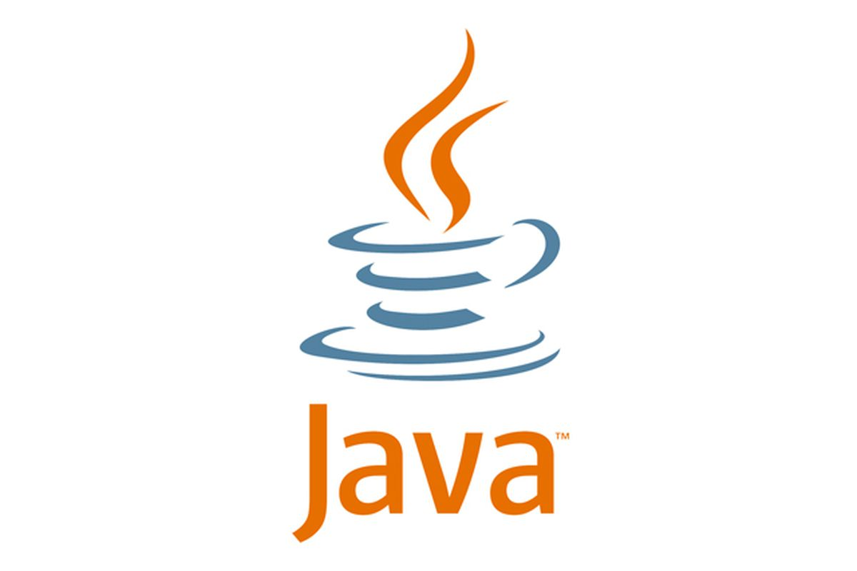
Core Java

Slide 2
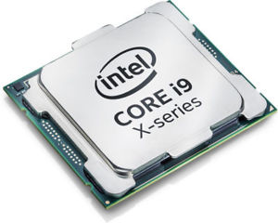
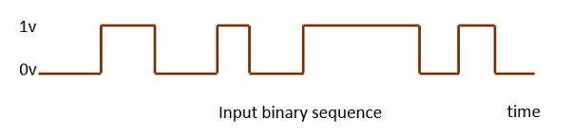

Fundamentals
A computer is an electronic device capable of performing computations.
The heart of the computer is its processor.
A computer understands only electronic signals, a zero volt representing a binary 0 and five volt representing a binary 1.
8 bits of such signals are grouped together to represent texts, numerical and symbols and are identified by unique patterns.
Current processors are capable of understanding and decoding 64 bits at a time.
10101010
This is 8 bit computing
ADD
10000011
Notes:
But what is the relation of this concept with the programming language JAVA. Let understand these with an example.

Slide 3
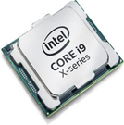
Fundamentals
Suppose we are asked to add 2 numbers – say 1 + 2
In Assembly language
Store 1 at memory location A
Store 2 at memory location B
Add the contents of A & B
Store the result
OS Calls – provide function calls to display the results.
C Language
printf(1 + 2)
101000101010
assembler
compiler
Assembly code
101000101010
assembler
Notes:
Assembly Language is the most elementary form of software development languages.”

Slide 4
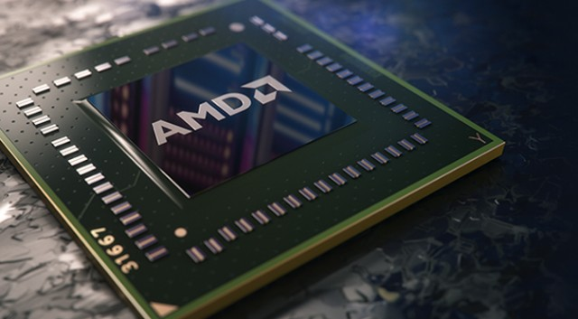
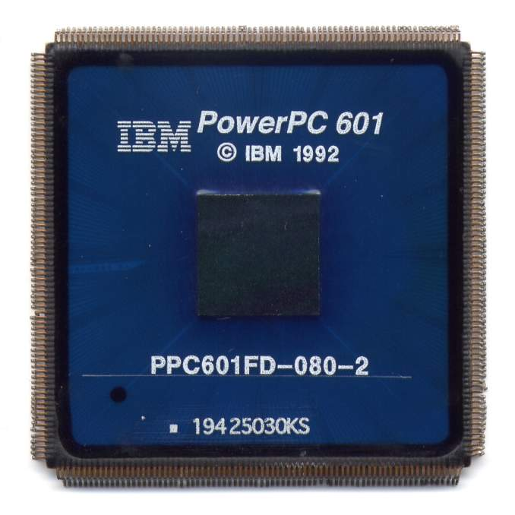
Fundamentals
Operating System
Processor
Platform
Common platforms
Windows + Intel
Linux + AMD
Mac + PowerPC
Android + MediaTek
Assembly instructions change with change in processor…
ADD instruction
ADD
ADDITION
MATH ADD
Also with change in OS, the level of OS calls will also change…
We end up using platform specific compilers.

Slide 5
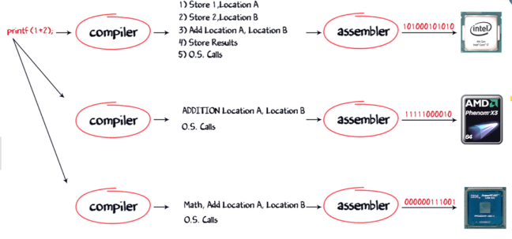
Fundamentals
Separate compilers which convert my printf command into the native machine code.

Slide 6
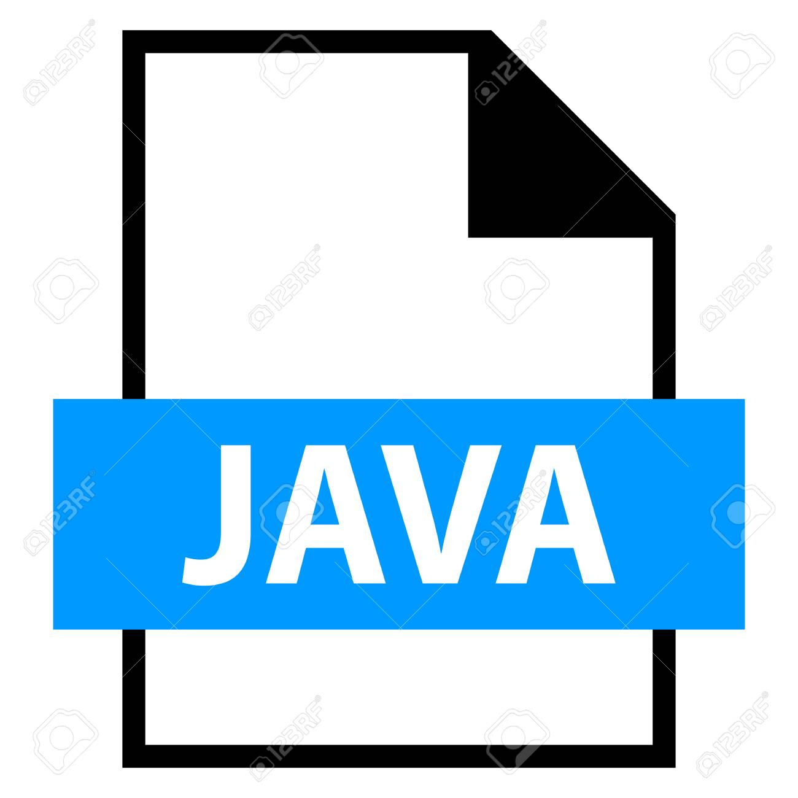

Java Virtual Machine
System.out.println(1 + 2);
Java compiler
101000101010
saved as a .java file
JVM
11111000010
intermediate bytecode
000000111001
Hence Java is a LANGUAGE as well as a PLATFORM

Slide 7
C Compiling and Execution
C Language compiling and linking
a1.c
main() {
f1();
f2();
}
RAM
a1.obj
a2.c
f1() {
}
compiler
a2.obj
linker
a.exe
a.exe
a3.c
a3.obj
f2() {
}
Machine code

Slide 8
Java Virtual Machine
RAM
Java Language compiling and linking
a1.java
JVM
main() {
f1();
f2();
}
ClassLoader
a1.class
Bytecode Verifier
a1.class
a2.java
f1() {
}
compiler
a2.class
a2.class
Execution Engine
a3.java
a3.class
a3.class
f2() {
}
Byte code
JIT compiler

Slide 9
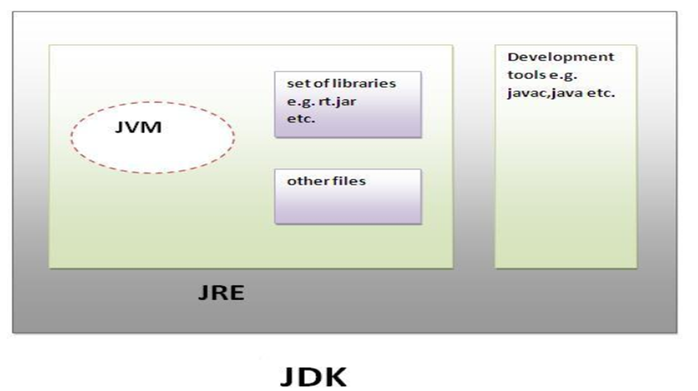
Java Virtual Machine
JDK, JRE and JVM
JVM (Java Virtual Machine) is an abstract machine. It is a specification that provides runtime environment in which java bytecode can be executed.
JRE is the implementation of JVM. It physically exists. It contains set of libraries + other files that JVM uses at runtime.
JDK contains JRE + development tools.

Slide 10
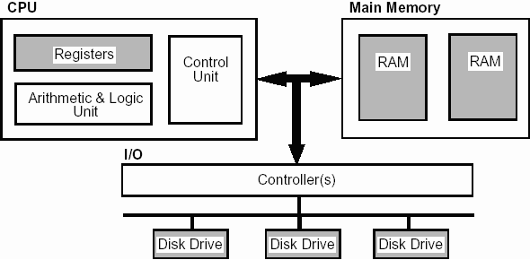
Java Virtual Machine
Just-in-Time Compilers: An Overview
Computers—can execute only a relatively few, specific instructions, which are called assembly or binary code.
Languages like C++/ Fortran, are compiled languages as their programs are delivered as binary.
The assembly code in that binary is targeted to a particular CPU.
Languages like PHP/Perl are interpreted. The interpreter translates each line into binary as that line is executed.
Factors that a good compiler takes into account
Lets consider adding 2 numbers.
A good compiler will produce a binary that
executes the statement to load the data,
executes some other instructions,
and then when the data is available,
executes the addition.

Slide 11
Java Virtual Machine
Just-in-Time Compilers: An Overview
Java attempts to find a middle ground here.
Java applications are compiled—but instead of being compiled into a specific binary, they are compiled into an idealized assembly language.
Because it is executing an idealized binary code, the java program is able to compile the code into the platform binary as the code executes.
This compilation occurs as the program is executed: it happens “Just In Time.”

Slide 12
Java Virtual Machine
Hot Spot Compilation
This name (HotSpot) comes from the approach it takes toward compiling the code.
In a typical program, only a small subset of code is executed frequently, and the performance of an application depends primarily on how fast those sections of code are executed.
These critical sections are known as the hot spots of the application; the more the section of code is executed, the hotter that section is said to be.
When the JVM starts executing code, it does not begin compiling the code immediately.
First:
If the code is going to be executed only once, then compiling it is essentially a wasted effort.
If the code is a frequently called method, or a loop that runs many iterations, then compiling it is worthwhile.
Second:
Optimization: more times that the JVM executes a particular method or loop, the more information it has about that code.

